Slide 1
North American Wildlife
Ch 1
Principles of Zoology

Slide 2
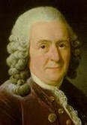
What is Taxonomy?
The science of classification.
Classification is…putting organisms into categories based on their physical and/or genetic similarities to one another.
Carolus Linnaeus

Slide 3
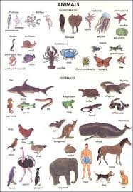
How are organisms classified?
Domain
Kingdom
Phylum
Class
Order
Family
Genus
Species

Slide 4
Domain
Eukaryote
Prokaryote

Slide 5
Kingdoms
Animalia
Plantae
Fungi
Protista
Eubacteria
Archeabacteria

Slide 6
Phylum
Smaller, more specific grouping than Kingdoms.
Over 30 animal phyla, but 8 major phyla:
Cnidaria
Mollusca
Annelida
Arthropoda
Platyhelminthes
Nematoda
Echinodermata
Chordata- subphylum Vertebrata (our focus!)

Slide 7
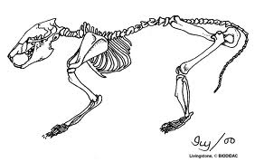
Class
Smaller, more specific grouping than phylum.
Chordata classes: Amphibia, Aves, Mammalia, Reptilia, etc.

Slide 8
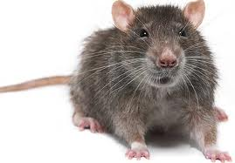
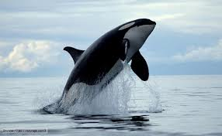
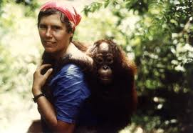
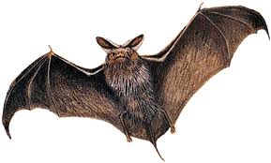
Order
Smaller, more specific grouping class.
Mammalian orders: Primates, Chiroptera, Carnivora, Cetacea, Rodentia, etc.

Slide 9
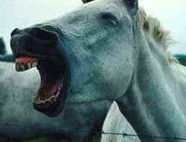
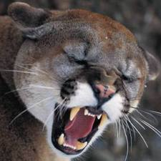
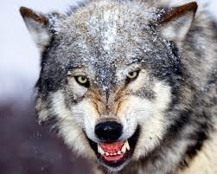
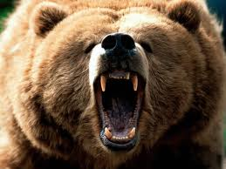
Family
Smaller, more specific grouping than Orders.
Some mammalian animal families: Felidae, Equidae, Canidae, Ursidae, etc.

Slide 10
Genus species
Scientific name
Genus is ALWAYS capitalized.
Species is ALWAYS lower case.
Both either: Genus species
Or: Genus species

Slide 11
Examples of scientific names
Felis catus
Felis sylvestris
Lynx rufus
Canis familiaris
Canis lupus
Maleagris gallapavo sylvestris
Odocoileus virginianus
Myotis lucifugis
Gorilla gorilla
Pan troglodytes
Homo sapiens

Slide 12
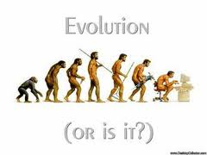
Complete human classification
Domain: Eukarya
Kingdom: Animalia
Phylum: Chordata
Class: Mammalia
Order: Primates
Family: Hominidae
Genus: Homo
Species: Homo sapiens

Slide 13
Animal Behaviors and Habits
Things animals do in order to survive and thrive.
Example: getting food, migrating, hibernating, attracting mates, escaping predators, finding or building shelter, etc.

Slide 14
Animal Anatomy
Physical adaptations that allow an animal to survive in their particular habitat.
Examples:
Polar bear- thick coat
Carnivores- sharp teeth
Birds- feathers to fly
Rabbit (other prey)- excellent hearing

Slide 15
Animal Nutrition and Digestion
What animals eat depends on many factors.
How are they designed physically?
A.K.A. -adaptations
What are their behaviors and habits?
At what trophic level do they exist?
Simple stomach vs. Rumen (chambered stomach)
Crop and gizzard
Teeth

Slide 16
Animal Growth
All animals start out as a joining of two single cells and divide through the process of mitosis.
As the cells divide, the organism grows and develops.
Stages of mitosis are: Prophase, Metaphase, Anaphase, Telophase
A non-dividing cell is in Interphase.

Slide 17
Animal Reproduction
Meiosis is the formation of sex cells, i.e. sperm and egg.
Each sex cell or gamete, carries chromosomes from each parent.
When the gametes join, they form a zygote which then divides through the process of mitosis to form an embryo.
The embryo then develops into a complete organism.

