Slide 1
Environmental Science Mr. Shaut
Unit 1
The Ecosystem

Slide 2
Objectives:
Understand the terms BIOLOGY and ZOOLOGY.
List the classification levels of taxonomy.
Understand trophic levels, pyramids of numbers, energy, and biomass.

Slide 3
What is Biology?
The study of living things.
Exploring life processes of all of the kingdoms of organisms.

Slide 4
What is zoology?
Branch of biology dealing with ANIMALS.
Life, growth, anatomy, nutrition, reproduction, and classification of animal species.

Slide 5
Abiotic vs. Biotic
Abiotic refers to all of the non-living things on Planet Earth.
Examples include:
Air (nitrogen, oxygen, carbon dioxide, etc.)
Water
Light
Temperature
Wind
Minerals
Soil (some parts)

Slide 6
Abiotic vs. Biotic
Biotic refers to all of the living things (organisms) on Planet Earth.
Examples include:
The 6 Kingdoms

Slide 7
The 2 Domains
Eukaryotes- their cells have membranes around the organelles.
Prokaryotes-their cells lack membranes around the organelles.

Slide 8
The 6 Kingdoms
Animalia
Plantae
Fungi
Protista
Eubacteria
Archaebacteria (extremophiles)

Slide 9
What makes something BIOTIC?
The 7 Life Functions:
Movement
Sensitivity (Irritability)
Growth
Nutrition
Respiration
Excretion
Reproduction

Slide 10
The 7 Life Functions
Movement is-
An organism changing locations or body position.

Slide 11
The 7 Life Functions
Sensitivity-
An organism’s ability to sense and respond to the world around them.

Slide 12
The 7 Life Functions
Growth-
Getting bigger.

Slide 13
The 7 Life Functions
Nutrition-
Taking in and processing food.

Slide 14
The 7 Life Functions
Respiration-
Turning food and oxygen into energy that is useful to the body.

Slide 15
The 7 Life Functions
Excretion-
Getting rid of metabolic waste products.

Slide 16
The 7 Life Functions
Reproduction-
Making more of the species.

Slide 17
Homeostasis
Maintaining a balanced internal environment in response to an ever changing outside environment.

Slide 18
Community Life
Producers-
Autotrophs- “self feeder”
Those organisms that can make their own food using molecules from the environment.
Examples include- plants, some protists, and some bacteria.

Slide 19
Community Life
Consumers-
Heterotrophs- “other feeder”
Those organisms that must rely on eating other organism in order to survive.
Examples include: animals, fungi, most protists and most bacteria.
Some plants supplement their diets in this way. Ex. Venus Fly Trap, Pitcher Plants

Slide 20
Community Life
Decomposers
Saprophytes-
Those organisms that obtain nutrients by breaking down dead organisms and waste products.
Example include: Fungi and most bacteria.

Slide 21
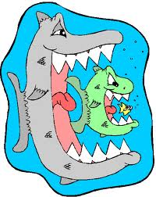
Food Chains
Huh?

Slide 22
Food Chains
Scary!

Slide 23
Food Chains
Very scary!
…but, inevitable!

Slide 24
Food Chains
Producers
Primary Consumers (Herbivores)
Secondary Consumers (Carnivores)
Tertiary Consumers (Omnivores)
Decomposers

Slide 25
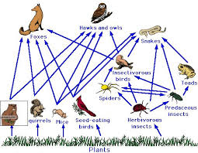
Food Webs
Many food chains interacting with one another.

Slide 26
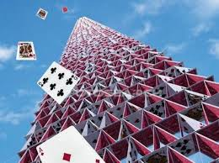
Food Webs
What happens if one or two organisms from the food web are removed?

Slide 27
Food Webs
All organisms have a place, a role.
Niche- An organism’s role in the environment.
Habitat- Where and organism lives in it’s environment.

